Slide 1


Hackathon Project #3
Predictions of Future Allergy and Atopic Disease Rates Across the Globe

Slide 2

Objective
Can we predict the levels of allergies and atopic disease (eczema, atopic dermatitis) in key marketplaces across the globe to understand the future need for personal skin care products to design formulas to support the more delicate skin of these consumers?
Can we achieve epidemiological insights without being an epidemiologist?

Slide 3
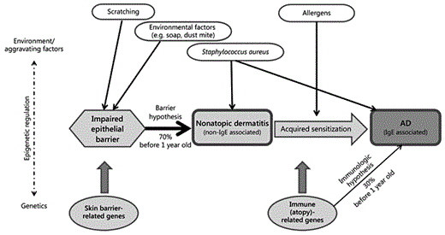
What is Atopic Dermatitis (AD)/Eczema?
Chronic inflammatory and allergic skin diseases
Part of Chronic Allergic diseases (allergic asthma, atopic dermatitis, eczema, allergic rhinitis, food allergies)
Red, itchy, dry spots and rashes that come and go on the skin
Several hypotheses to explain development of these diseases:
Outside factors constantly assault skin causing weakening of the barrier to repel things that cause inflammation and allergic reactions
Genetics and other issues cause a pre-existing weakness of the skin barrier to repel things that cause inflammation and allergic reactions
Inherent weakness of the skin barrier due to inability to develop tolerance for environmental insults and microbes as a child causes increased sensitivity to the environment

Slide 4
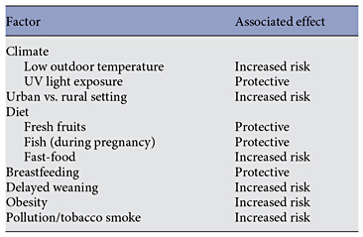
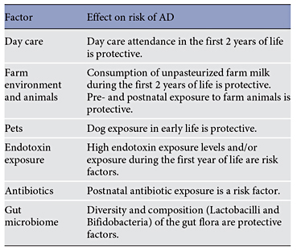
Risk factors for AD:
Risk factors in Atopic Dermatitis/Eczema
Food allergies (exacerbating factor)
Genetics (Filaggrin gene mutations with recessive pattern of inheritance; mutations occur in 30% of AD/eczema sufferers)
Environmental risk factors (see table)
Climate
UV light exposure
Pollution
Sex (Females more likely to have disease)
Socioeconomic status (global region-dependent)
Age- childhood prevalence is greater than adult disease levels
Taken from https://doi.org/10.1159/000370220

Slide 5
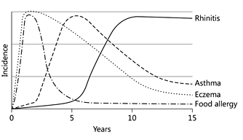
Some AD/Eczema Statistics
https://doi.org/10.1159/000370220
Chronic Allergic diseases (allergic asthma, atopic dermatitis, eczema, allergic rhinitis, food allergies)
Eczema/Atopic dermatitis affects ~3-10% adults (~2019 U.S.)
20% adults with atopic dermatitis/eczema also have asthma
20% children with mild eczema develop asthma (atopic march)
19% infants with food allergies also presented with eczema
Eczema/Atopic dermatitis is connected to allergies
Allergy research may therefore be useful for making assessments about AD incidence

Slide 6
Scope for predicting future disease rates
Representative Global Regions of Interest that could be examined
China, United States, Europe, Latin America
Age Ranges of Interest that could be explored
Adults (20-60yr; 65+ yr)
Children (<18yr, as future adult populations; assume 5% children still have disease as adult)
All genders in scope
Timeframe in scope
Disease levels upto 2035
Disease levels upto 2050

Slide 7
Possible Approaches
Build a model using data from ~2000-2023
Obtain studies showing trends in disease based on historical data for extrapolating future trends
Incidence rates
Population statistics
Current assumed contribution of risk factors
Characterize subset of risk factors
Set your own thresholds for how much change in the future equates to increased probabilities of a given risk factor for the future environment
Assign relative values to different risk factors
Probabilities and odds- ratios
Determine predicted changes in risk factors for future timeline
Meteological/Environmental changes
Pollution rates
Demographics of the region’s population
What are the demographic distribution of AD now?
What are the demographics of the future region?
Socio-economic factors and how the socioeconomic distribution is expected to change in the future
Examples
DOI: 10.3389/fmicb.2023.1161969 National situation, trends and predictions of disease burden in atopic dermatitis in Chinese children and adolescents. Front Microbiol. 2023
DOI: 10.1016/j.autrev.2023.103407 A global assessment of incidence trends of autoimmune diseases from 1990 to 2019 and predicted changes to 2040. Autoimmune Rev. 2023
doi: 10.1016/j.eclinm.2023.102193 Global, regional and national incidence of six major immune-mediated inflammatory diseases..eClinical Medicine 2023

Slide 8
Output-”You’re good, You!!” -Robert DeNiro- Analysis This
Identify the most reliable risk factors for Atopic Dermatitis/Eczema
Most reliable= most researched risk factors (upto 6) with strongest connections to AD
Create method to allow input of different relative values for each risk factor
Pick one global region of interest (eg, US)
Imagine the future environment of that global region
Adjust incidence rate based on change from the current environment
Describe approach, methods and variables applied

Slide 9
Output- Amazing job!
Identify the most reliable risk factors for Atopic Dermatitis/Eczema
Most reliable= most researched risk factors (upto 6) with strongest connections to AD
Using data mining techniques, assign their relative value to developing the disease in adulthood
Probabilities
Odds-ratio
Unique categorical that could be converted to a value (ie, strongest links)
Individual global regions of interest (eg, US)
Describe approach, methods and variables applied
Sex
Status
Genetics
Environment

Slide 10
Output- Super Hero Status!!
Predict “incidence rate” of atopic dermatitis (AD)/”eczema or skin allergy”*
One global region of interest
In Adults**
For 2035, and extrapolate to 2050
Describe approach, methods and variables applied
*Ideal, but if required, pivot to incident rates of allergies will suffice
**may require pivot to childhood incidence rate and then back-calculated to adults – assume 5-30% of children with AD/eczema or skin allergy will have it in adulthood

Slide 11
References to kick-start research
https://www.niams.nih.gov/health-topics/atopic-dermatitis
Global, regional, and national burden of allergic disorders and their risk factors in 204 countries and territories, from 1990 to 2019: A systematic analysis for the Global Burden of Disease Study 2019. doi: 10.3389/falgy.2022.887672
Laughter MR, Maymone MBC, Mashayekhi S, et al. The global burden of atopic dermatitis: lessons from the Global Burden of Disease Study 1990-2017. Br J Dermatol. 2021; 184(2): 304-309.
GBD Chronic Respiratory Disease Collaborators. Prevalence and attributable health burden of chronic respiratory diseases, 1990–2017: a systematic analysis for the Global Burden of Disease Study 2017. Lancet Respir Med. 2020; 8(6): 585-596.
Filaggrin in Atopic Dermatitis. DOI:https://doi.org/10.1016/j.jaci.2009.07.013
Atopic Dermatitis: Global Epidemiology and Risk https://doi.org/10.1159/000370220
Epidemiology of adult atopic dermatitis https://doi.org/10.1016/j.clindermatol.2018.05.007
Adult eczema prevalence and associations with asthma and other health and demographic factors: A US population–based studyJournal of Allergy and Clinical Immunology, Vol 132(5). 2013
Climatic Factors Are Associated with Childhood Eczema Prevalence in the United Stateshttps://doi.org/10.1038/jid.2013.19
Global Burden and Disease Study (2019) website: https://ghdx.healthdata.org/gbd-2019

Slide 12
Other References and Sources
Using global non-profit/government reports on environmental trends on pollution and climate change
https://www.oecd.org/environment/indicators-modelling-outlooks/49928853.pdf
https://www.epa.gov/clean-air-act-overview/air-pollution-current-and-future-challenges
United Nations: https://www.un.org/en/climatechange/reports#:~:text=Climate%20change%20is%20widespread%2C%20rapid,across%20the%20whole%20climate%20system.
Using sources for meterological predictions of global weather
https://www.weather.gov/hun/climateforecast
https://www.wpc.ncep.noaa.gov/

